Slide 1

Airline Safety
By Ajit Kolekar

Slide 2
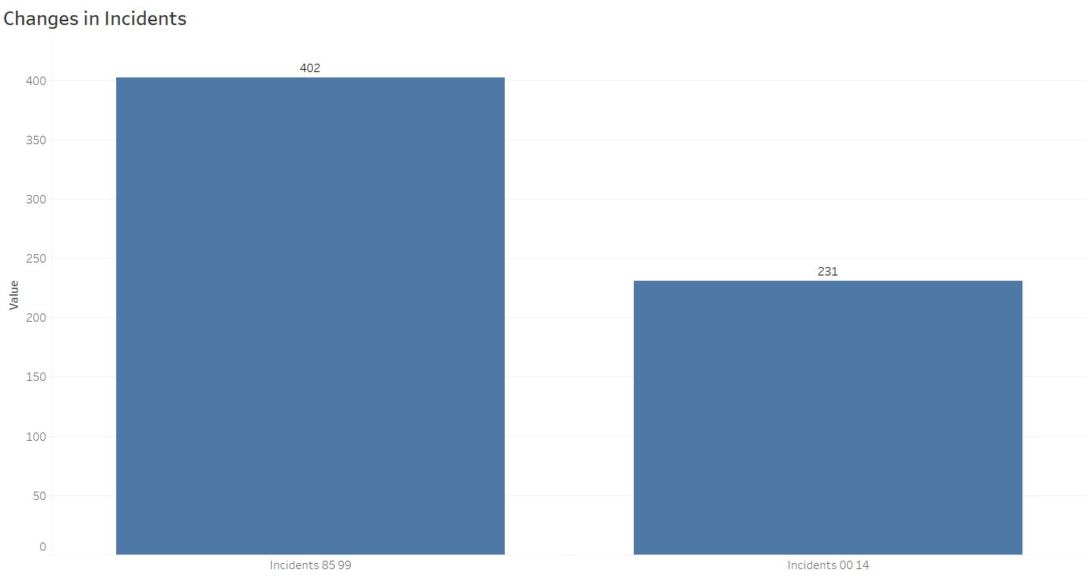
Changes in airline incidents over time
The airline incidents in 1984-1999 were 402
The airline incidents in 2000-2014 were 231
The number of incidents reduced significantly over time

Slide 3
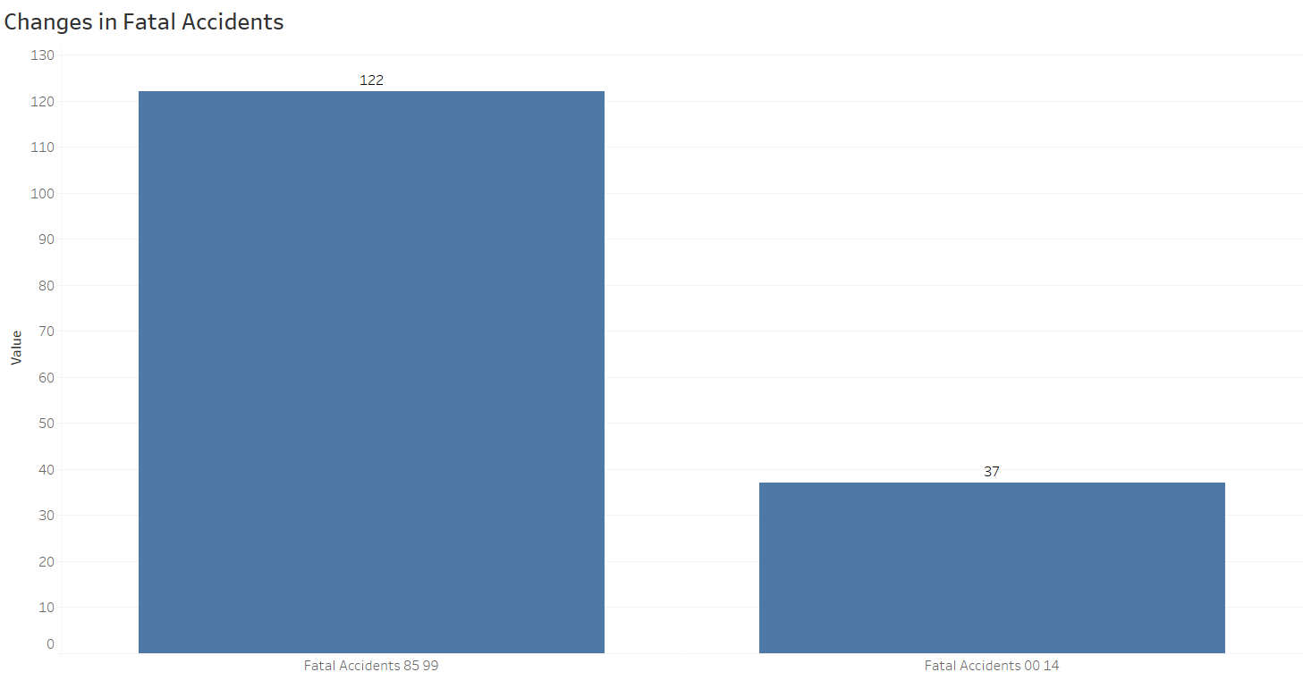
Changes in airline fatal accidents over time
The airline fatal accidents in 1984-1999 were 122
The airline fatal accidents in 2000-2014 were 37
The number of fatal accidents reduced significantly over time

Slide 4
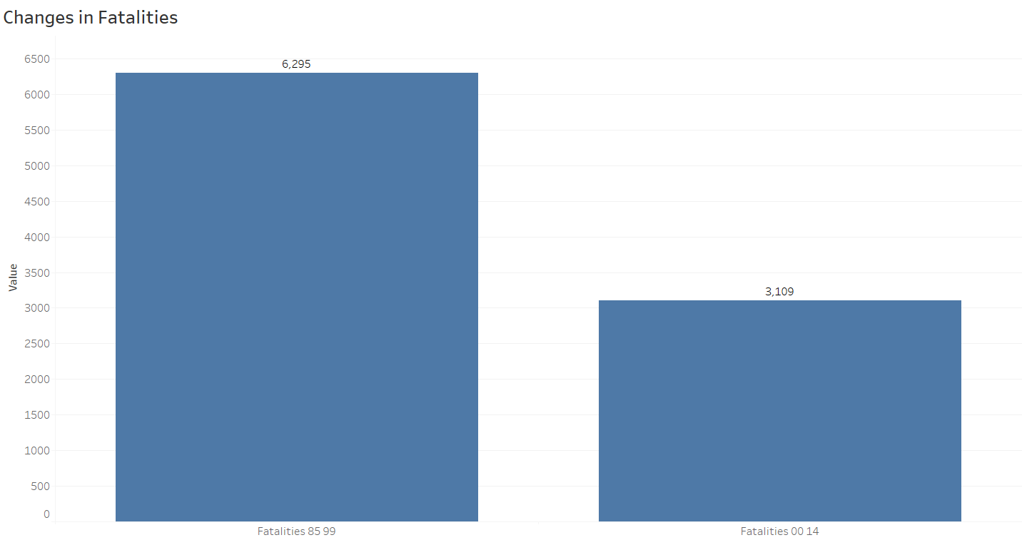
Changes in airline fatalities over time
The airline fatalities in 1984-1999 were 6,295
The airline fatalities in 2000-2014 were 3,109
The number of fatalities reduced significantly over time

Slide 5
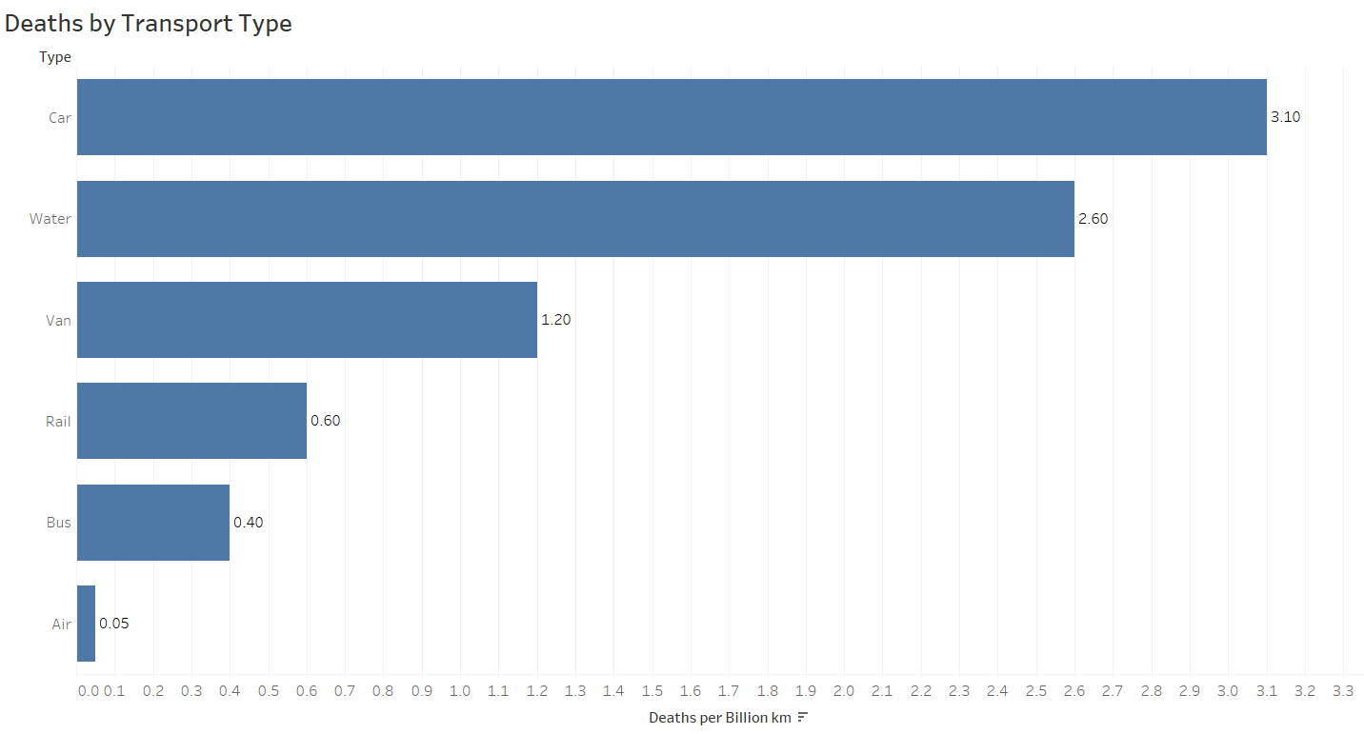
Deaths by Transport Type
In general, the average deaths per Billion kms for air travel were significantly lower than other transportation types
While the average deaths by car were 3.10, the same by air were only 0.05

Slide 6
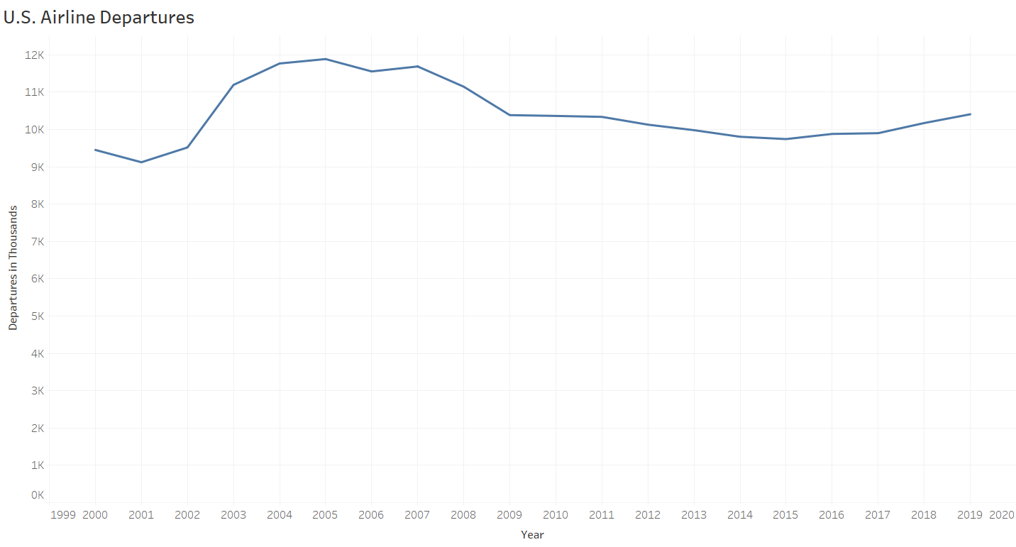
U.S. Airline Departures
The number of airline departures increased marginally through years 2000 and 2019

Slide 7
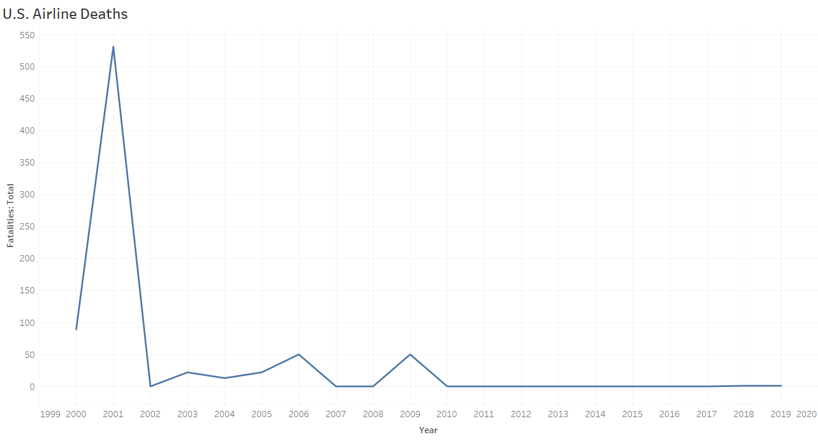
U.S. Airline Deaths
The number of airline deaths significantly reduced through years 2000 and 2019, and have been very low since year 2010
The outlier in year 2001 was due to terrorist attack

Slide 8
Summary
The airline incidents, fatal accidents, and fatalities have significantly reduced in the recent years
The average deaths by air have been the lowest compared to other transport types, such as Car, Water, Van, Rail, and Bus
While the number of departures in U.S. have marginally increased between years 2000 and 2019, the number of fatalities have significantly reduced close to zero
This analysis concludes that airline travel is the safest mode of traveling

Slide 9
References
Wikimedia Foundation. (2021, September 17). Aviation safety. Wikipedia. https://en.wikipedia.org/wiki/Aviation_safety
G, E. (n.d.). U.S. airline traffic and capacity. Airlines For America. https://www.airlines.org/dataset/annual-results-u-s-airlines-2/
G, E. (n.d.). Safety record of U.S. air carriers. Airlines For America. https://www.airlines.org/dataset/safety-record-of-u-s-air-carriers/

